Slide 1
UT Registration Dashboard
For live tracking and monitoring the proposal sent, received and pending with officials
Developed by Mr Sumit Kumar, DEO, UT Division, MHA

Slide 2
Description about the project
UT Reg. Dashboard is fully functional and responsive dashboard framework is creating with latest technologies i.e. Python, Django and Flask etc.
UTRD – is responsible for tracking and monitoring Realtime issues/proposals sent or generated by MHA and other Ministries or Department of Govt of India.
Features need to be implemented: UTRD is comprising with major 2 modules i.e. “Active” and “Non-Active”.
Active Module consisting further UT selection and shortlisting of particular UT with pending proposals/Issues.
Non-Active Module comprising with Date of Proposal, About the Proposal, Last Action Taken with department and Pending with which department etc.

Slide 3
Contd.
Further, Name of UT module having name of all UTs of India are Delhi, Lakshadweep, DNH&DD, Chandigarh, Puducherry, Andaman & Nicobar Islands, Jammu & Kashmir and Ladakh.
Also, UTRD having three major category -> MHA, Stakeholders & DCN/FCN of each proposals/issue.
Name of Stakeholders, and why is pending to which department?
Each proposal must have “Date of proposal sent and received”.
Each proposal should have a brief description/about.

Slide 4
Contd.
Status of Proposal:
Last action taken, why sent?
Pending proposal since?
Date of proposal -> About and Last Action and pending with which department.

Slide 5
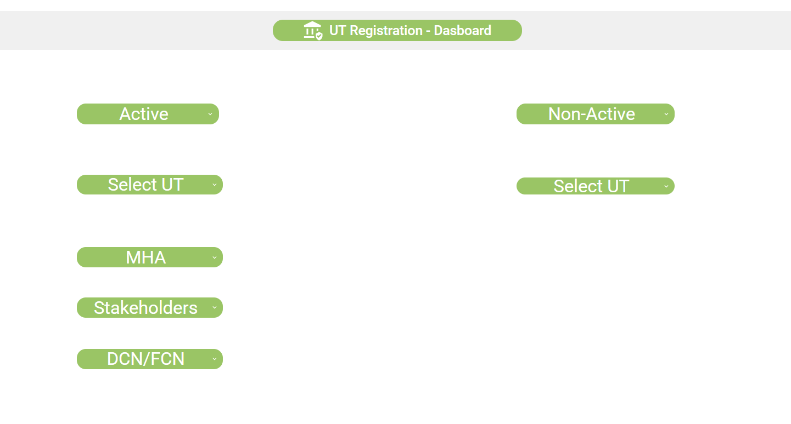
Workflow of UTRD
Name of Stakeholders
Pending with & Why
Pending since
Last status why sent?
Delhi
Chandigarh
DNH & DD
Lakshadweep
Delhi
Chandigarh
DNH & DD
Lakshadweep
Name of Stakeholders
Pending with & Why
Pending since
Last status why sent?
Date of Proposal
About the proposal
Last Action taken
Pending with
Name of Stakeholders
Name of Stakeholders
Pending with & Why
Pending since
Last status why sent?

